Slide 1
Orthogonal Contrasts
Gemma Wallace & Neil Yetz
Psy 653 Module 2 lab
Mar 4, 2020

Slide 2
A Quick Review of Planned Contrasts
Contrasts test a specific hypothesis related to group means based upon some prior information about the groups.
Contrasts assign a weight to each of the groups in your predictor variable
Weights should add up to zero
Assigning a weight of zero means that group will not be included in the contrast
Order of the weights corresponds to order of groups in predictor variable
Contrasts are one-tailed (we are testing specific hypotheses)

Slide 3
An example of a planned contrast set-up:
 | Control | Drug A | Drug B
Contrast 1 | -1 | 1/2 | 1/2
Contrast 2 | 0 | -1 | 1
o Contrast 1 tests whether or not the control group differs from the groups that received a drug treatment
o Contrast 2 tests whether or not the two drugs differ in their effect.

Slide 4
Orthogonal Contrasts
A set of contrasts is orthogonal if:
o The number of contrasts = df (number of groups -1)
o You have at least 3 groups to compare
o Two contrasts are orthogonal if the pairwise products of the corresponding coefficients for each term sum to zero:
 | Control | Drug A | Drug B
Contrast 1 | -1 | 1/2 | 1/2
Contrast 2 | 0 | -1 | 1
These contrasts are orthogonal because: (-1 *0) + (1/2 * -1) + (1/2 * 1) = 0

Slide 5
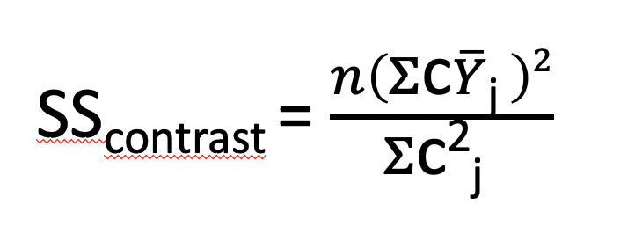
Relevant formulas
We can use orthogonal contrasts to get a lot of information about a dataset, even if we don’t have a full ANOVA table!
Sums of Squares for each contrast:
n = n/cell
cj is a set of contrast weights
Ŷj is the mean of the DV in group j
Sum of Squares Treatments:
SS_{treatments} = SS_{contrast1} + SS_{contrast2} + …SS_{contrastk}
Sum of Squares Total:
SS_{total} = SS_{contrast1} + SS_{contrast2} + …SS_{contrastk} + SS_{error}
Notes:
Make note: you can go through these steps just for SStreatments too! (Doesn’t need to only by the contrasts themselves)

Slide 6
Breaking down the example from Module 2 lecture
 | Mean | Contrast 1 | Contrast 2
Group 1 | 35 | -1 | 1
Group 2 | 40 | -1 | -1
Group 3 | 45 | 2 | 0
Note: We could use different contrast weights, depending on our specific research question and a priori information.
N for this study was 90 (i.e., 30 subjects/cell in this design)
SS_{total} = 5000

Slide 7
Breaking down the example from Module 2 lecture
 | Mean | Contrast 1 | Contrast 2
Group 1 | 35 | -1 | 1
Group 2 | 40 | -1 | -1
Group 3 | 45 | 2 | 0
Contrast 1 tests whether the mean of Y for treatment group 3 was significantly different than the means of the other two groups.
Contrast 2 tests the hypothesis that the mean of group 1 was significantly different than the mean of group 2.

Slide 8
Breaking down the example from Module 2 lecture
 | Mean | Contrast 1 | Contrast 2
Group 1 | 35 | -1 | 1
Group 2 | 40 | -1 | -1
Group 3 | 45 | 2 | 0
In this demo we walk through how to test the hypothesis that the mean of group 3 was significantly different from the mean of participants in groups 1 and 2 (i.e., testing the significance of Contrast 1)
We encourage you to go through these steps for Contrast 2 on your own for practice :)

Slide 9
Calculate Sums of Squares for the contrast
 | Mean | Contrast 1
Group 1 | 35 | -1
Group 2 | 40 | -1
Group 3 | 45 | 2
N/cell = 30
SS_{contrast1} = [30 * ((35 * -1) + (40 * -1) + (45 * 2))^2] / (-1)^2 + (-1)^2 + (2)^2
SS_{contrast1} = [30 * (15)^2 ]/6
SS_{contrast1} = [30 * 225]/6
SS_{contrast1} = 6750/6 = 1125

Slide 10
2) Calculate eta-squared for the contrast
Note: if you are not given SS_{total} you can calculate this from the SD and mean of Y!
Eta²_{contrast}= SS_{contrast}/SS_{total}
SS_{total} = SS_{contrast1} + SS_{contrast2} + SS_{error} = 5000 (this was given to us)
Eta²_{contrast1} = 1125/5000 = 0.225
22.5% variance in Y explained by this contrast

Slide 11
2) Calculate eta-squared for contrast
Eta²_{contrast}= SS_{contrast}/SS_{total}
SS_{total} = SS_{contrast1} + SS_{contrast2} + SS_{error}
Eta²_{contrast1} = 1125/5000 = 0.225
22.5% variance in Y explained by this contrast
1125 is the SS_{contrast} from the previous slide
5000 is the SS_{total} that was given to us beforehand

Slide 12
3) Calculate the F statistic for the contrast
To calculate the F statistic for the contrast:
To use this formula, you need to first calculate the MS_{error}, which you can get from the SS_{error}:
F_{(dfhyp, dferr)} = SS_{contrast}/MS_{error}
SS_{error} = SS_{total} - SS_{contrast1} - SS_{contrast2}
MS_{error} = SS_{error}/(n - k)
First: MS_{error} = (5000 - 1125 - 375) / (90 - 3) = 3500/87 = 40.229
Second: F_{contrast1(2,87)} = SS_{contrast1}/40.229 = 1125/40.229 = 27.96
Note: SS_{contrast2} = 375. Calculate this on your own for practice or see the activity answer key.

Slide 13
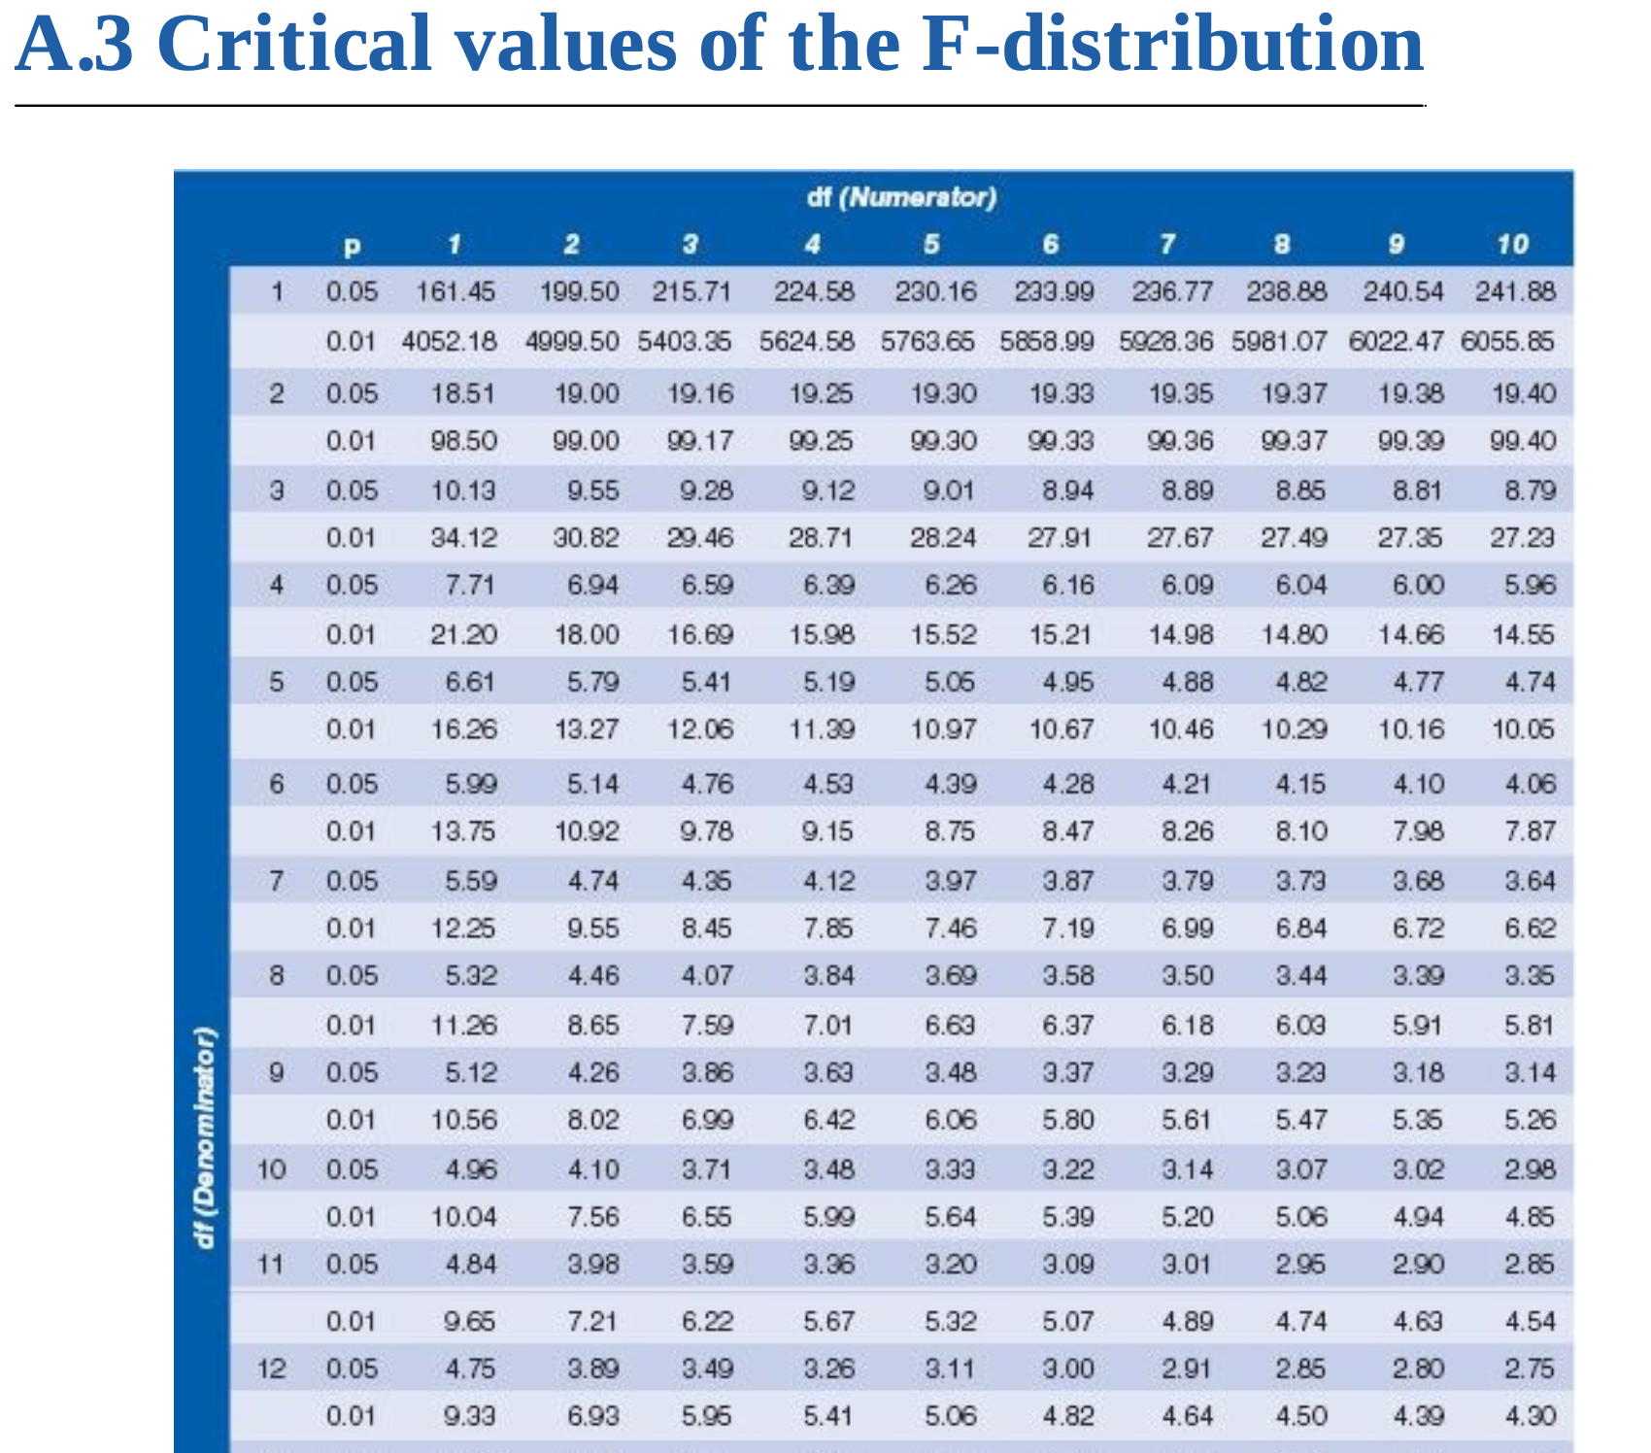
4) Determine the critical value of F
Use a critical F value table to determine the value your contrast’s F statistic needs to exceed in order to be considered significant
Field, Miles, & Field (2012) Table A.3 pp. 936-939
df numerator = k -1
df denominator = a proxy for the df error (n-k)
Round up to the next highest df denominator if your value isn’t listed

Slide 14
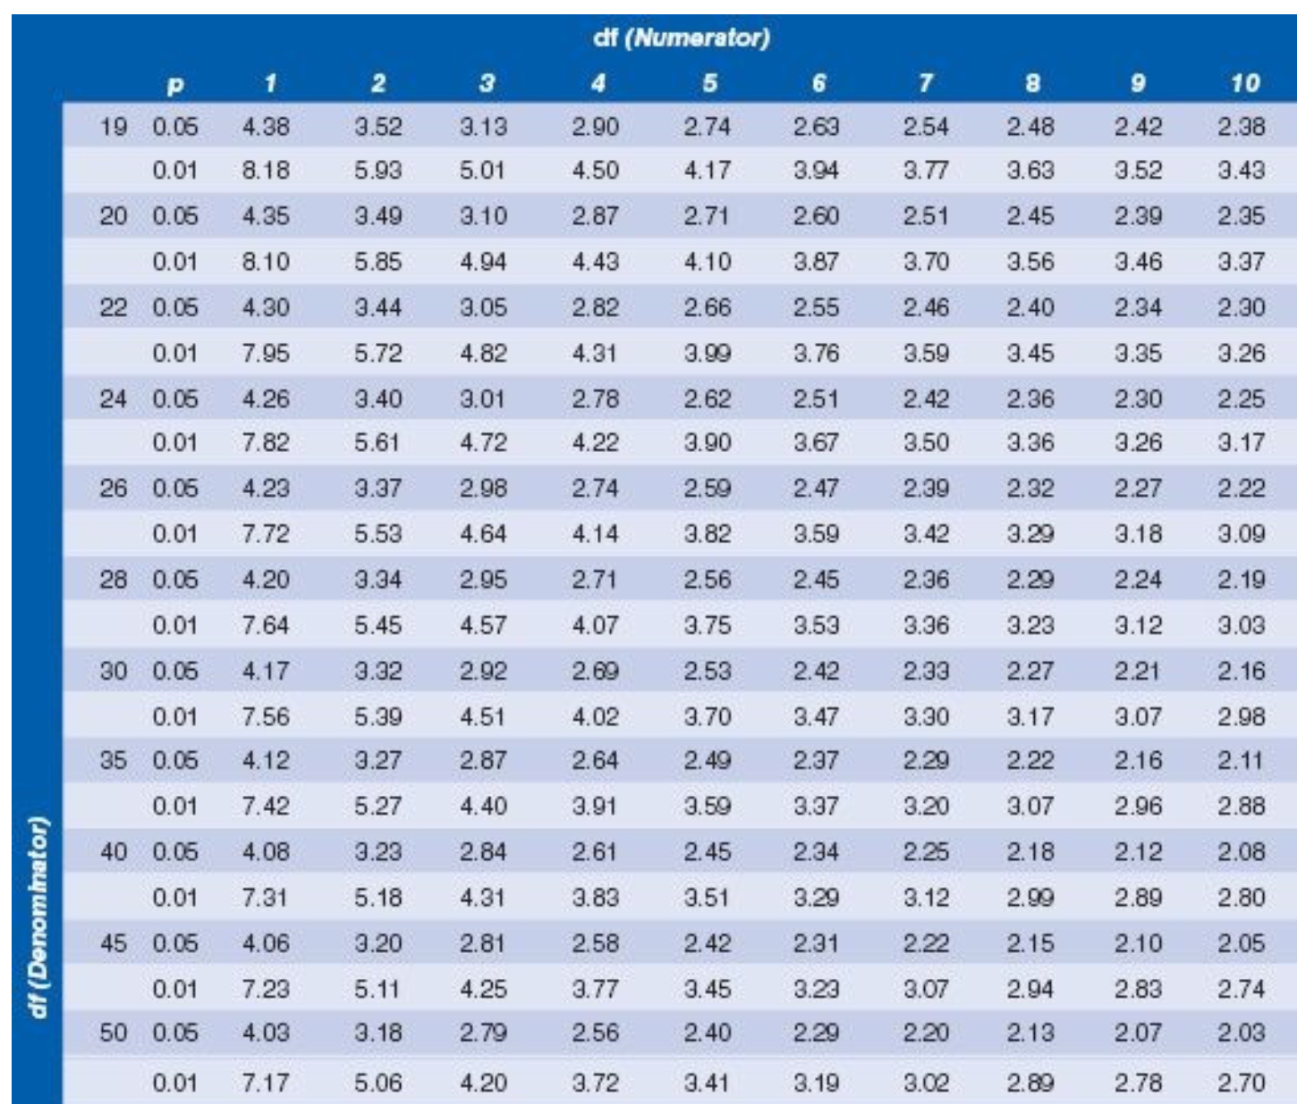

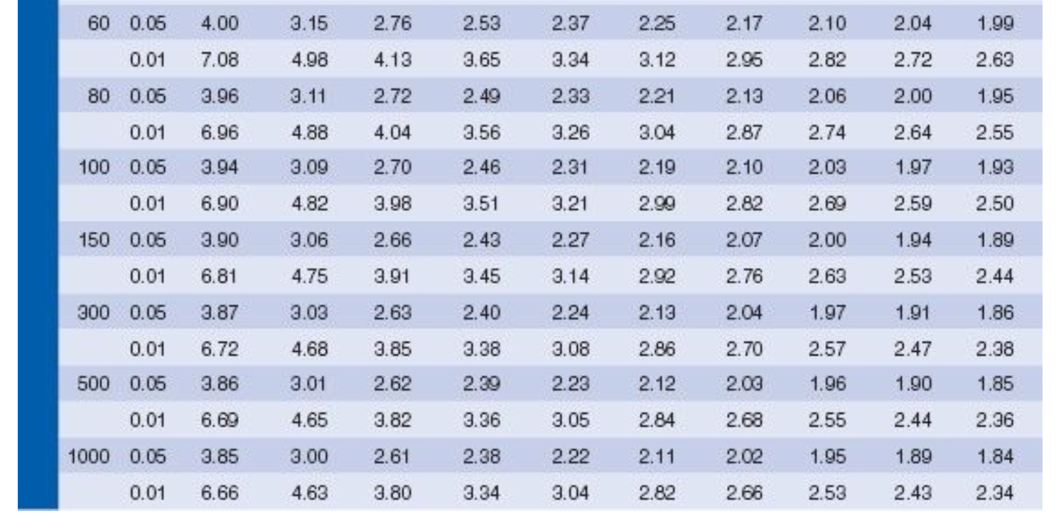
4) Determine the critical value of F
Df (Denominator)
df numerator = 2 (3 groups - 1 = 2)
df denominator = 87 (90 participants - 3 groups), round up to 100
The critical value of F for this ANOVA is 4.82 for an alpha of <0.01

Slide 15
4) Does the F statistic for the contrast exceed the critical value of F?
If yes, we can reject the null hypothesis and interpret the contrast as statistically significant.
F_{contrast1(2,87)} = 27.96
Since 27.96 > 4.82, this contrast is significant, indicating that the mean value of Y for participants in group 3 was significantly different than participants in groups 1 and 2.

